Slide 1
BIOE 598 Case Study 3: The Trebuchet Simulator
Presenter: Zong Fan
Email: zongfan2@illinois.edu
TEAM-ID: 2AOTEkjg

Slide 2
1. Research Objective
To adjust a trebuchet simulator with 3 parameters to hit a specified distance:
Fulcrum height (FH)
Counterweight mass (CM)
Sling length (SL)

Slide 3
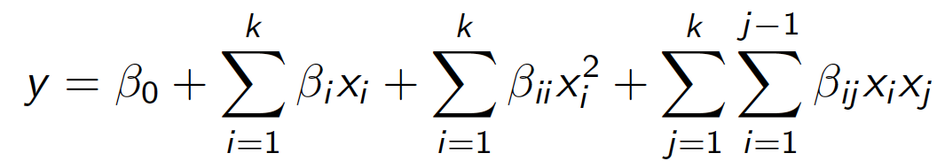
2. Method
In this case, instead of modeling distance (D) directly with 3 parameters, we could model the relation between the discrepancy with the parameters as:
Ideally, Err has the minimum value 0, so that the model should fit the curvature.
Response surfrace methodology is used to fit the nonlinear function f by:
k=3

Slide 4
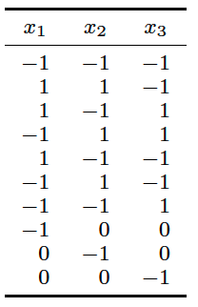



2.1 Hoke Designs
Choose Hoke Designs D2 for RSM, because traininng budget (12 runs) is too small for CCD and BBD.
Add another 2 runs at center points to test the lack of fit
+

Slide 5
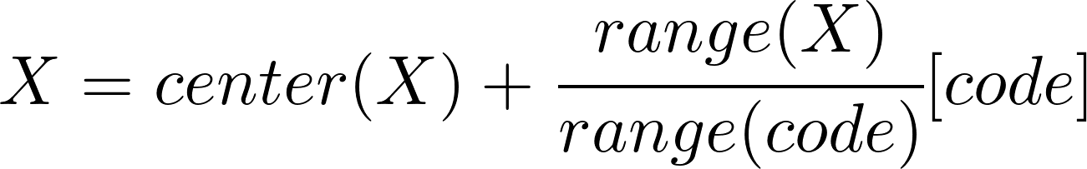




2.2 Data Coding
Use coding transformation of data to make all coded variables vary over the same range
Transformation formula:
Define the range of the FH, CM, SL to [0.3, 0.6], [8.5, 16.5], [0.3, 0.5], respectively, corresponding to code range [-1, 1].
Code-to-Value:
Value-to-Code:

Slide 6
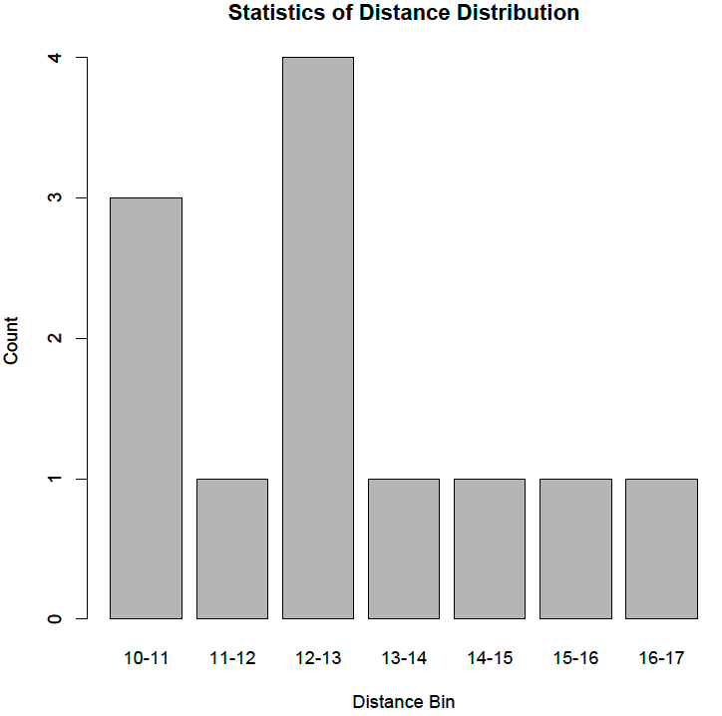
3. Training Data
FH | CM | SL | x1 | x2 | x3 | Block | D | ERR
0.3 | 8.5 | 0.3 | -1 | -1 | -1 | 1 | 10.93 | 4.07
0.6 | 16.5 | 0.3 | 1 | 1 | -1 | 1 | 14.75 | 0.25
0.6 | 8.5 | 0.5 | 1 | -1 | 1 | 1 | 10.4 | 4.6
0.3 | 16.5 | 0.5 | -1 | 1 | 1 | 1 | 12.48 | 2.52
0.6 | 8.5 | 0.3 | 1 | -1 | -1 | 1 | 11.85 | 3.15
0.3 | 16.5 | 0.3 | -1 | 1 | -1 | 1 | 12.69 | 2.31
0.3 | 8.5 | 0.5 | -1 | -1 | 1 | 1 | 13.09 | 1.91
0.3 | 12.5 | 0.4 | -1 | 0 | 0 | 1 | 15.66 | 0.66
0.45 | 8.5 | 0.4 | 0 | -1 | 0 | 1 | 13.01 | 1.99
0.45 | 12.5 | 0.3 | 0 | 0 | -1 | 1 | 13.85 | 1.15
0.45 | 12.5 | 0.4 | 0 | 0 | 0 | 1 | 14.84 | 0.16
0.45 | 12.5 | 0.4 | 0 | 0 | 0 | 1 | 13.52 | 1.48

Slide 7
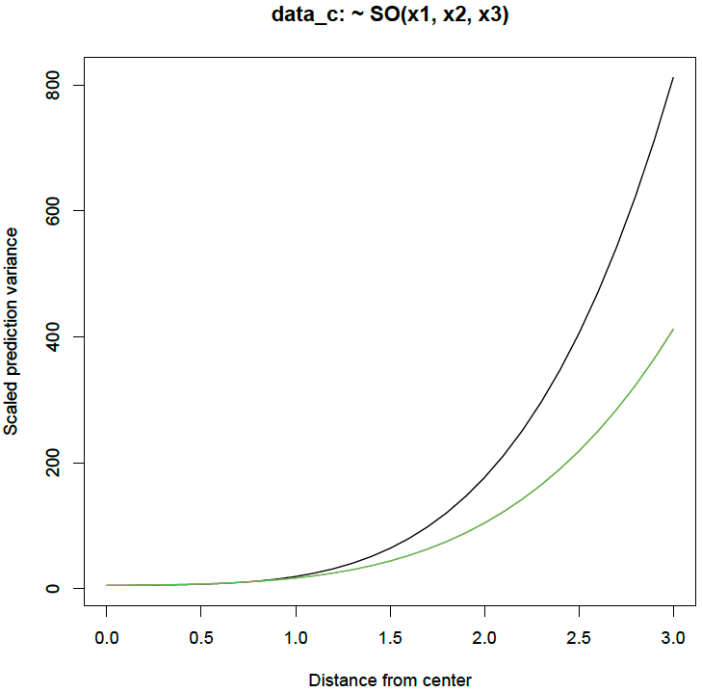
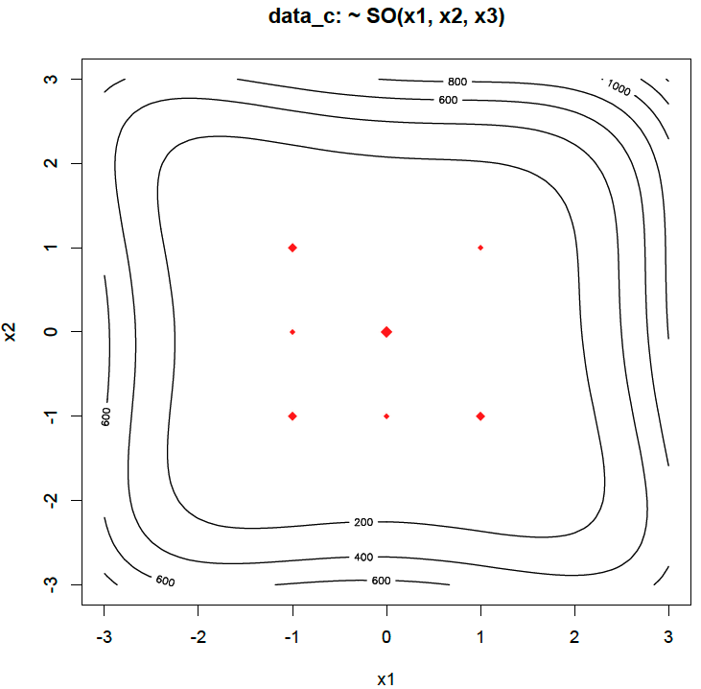
4. Results
4.1 Analysis of uniform precision and rotatable designs
In this case, hoke design has uniform precision but is not rotatable.

Slide 8
4.2 Fitting response-surface model
R-square=0.762, p-value=0.181
Stationary point is: x1=-3.86, x2=-0.91, x3 =1.82 or FH=-0.13, CM=8.87, SL=0.58
Obviously, the equation is not statistically signifcant, and the FH value at stationary point is < 0, which is also wierd.

Slide 9
4.3 Re-fitting
Rerun RSM after removing statistically and practically insignificant terms:
TWI(x1, x2)
PQ(x1)
R-square=0.832, p-value=0.026 (Significant!)
Stationary point is: x1=-0.16, x2=0.29, x3 =-0.27 or FH=0.43, CM=13.67, SL=0.37
Eigenvalues: λ1=1.58, λ2=0.82, λ3=-0.22 => Its stationary point is a saddle point.

Slide 10
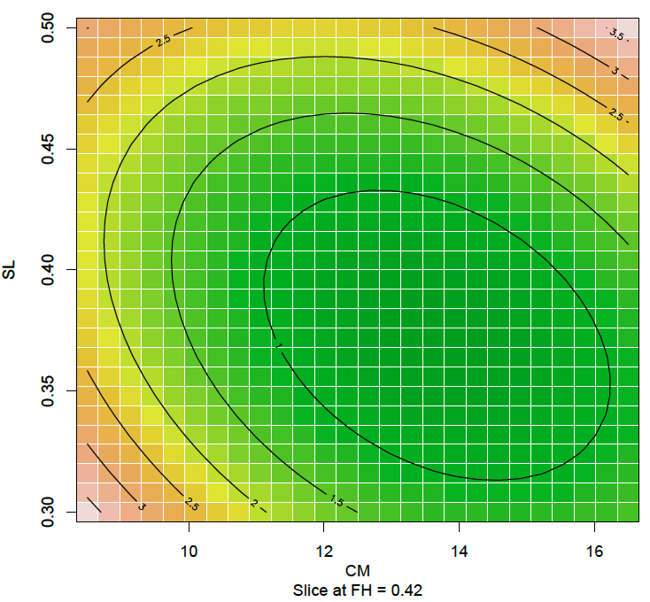
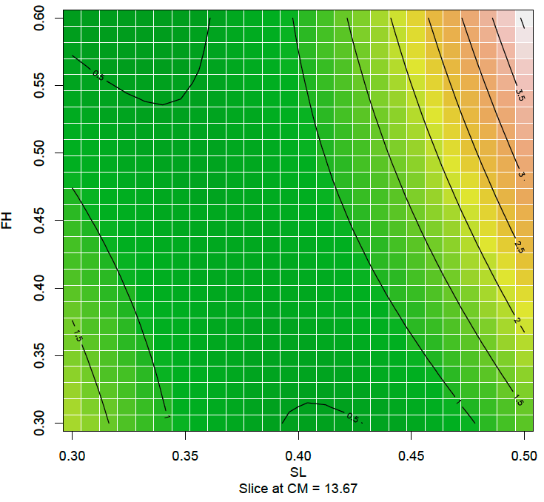
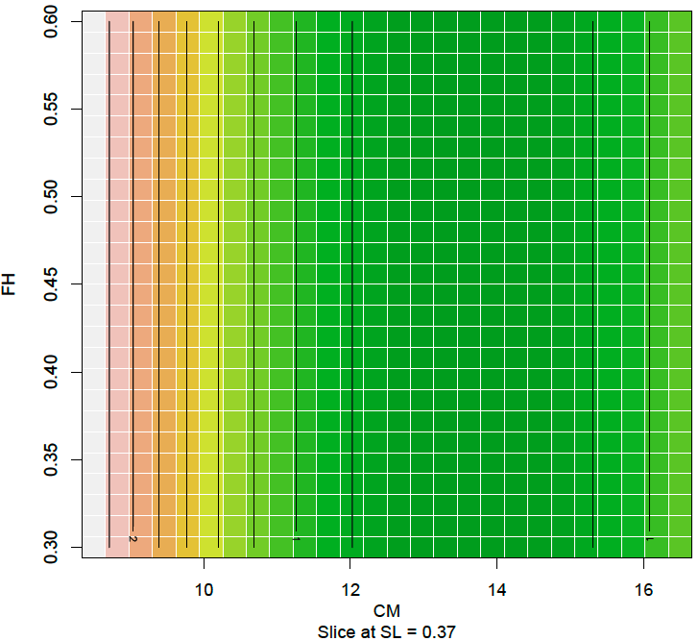
4.4 Displaying response surface
Fitted response-surface contour plot near the stationary point
Canoical path analysis of the stationary point indicates it seems to be the minimum value. So our strategy to approach Err=0 is jittering around the stationary point. Particularly, freeze SL because its effect size is largest.

Slide 11
4.5 Testing Data
FH | CM | SL | x1 | x2 | x3 | D | ERR
0.42 | 13.7 | 0.37 | -0.2 | 0.3 | -0.3 | 15.7 | 0.7
0.42 | 13.68 | 0.37 | -0.2 | 0.3 | -0.3 | 14.04 | 0.96
0.42 | 13.69 | 0.37 | -0.2 | 0.3 | -0.3 | 15.97 | 0.97
0.42 | 13.7 | 0.37 | -0.2 | 0.3 | -0.3 | 15.2 | 0.2
0.42 | 13.7 | 0.37 | -0.2 | 0.3 | -0.3 | 16.06 | 1.06
0.41 | 13.7 | 0.37 | -0.27 | 0.3 | -0.3 | 15.53 | 0.53
0.41 | 13.7 | 0.37 | -0.27 | 0.3 | -0.3 | 14.64 | 0.36
0.41 | 13.7 | 0.37 | -0.27 | 0.3 | -0.3 | 13.7 | 1.3
mean(ERR) = 0.76, sd(ERR)=0.38
Close to predicted error at the stationary point (ERR_predict=0.627)

Slide 12
5. Conclusion
With 12 training runs, the estimated response-surface function could predict distance error by 0.776±0.38, close to the value at the stationary point.
The statistical significance of fitting function could be improved by removing insignificant terms in the second-order function.
There are actual values > 15, which means the estimated stationary point may not be the minimum. More experiment runs are needed to find the optima.

Slide 13
Appendix: 1. running code
contour(SO_model_sim, x1~x3,image=TRUE,at=data.frame(x2=0.2932412))
contour(SO_model_sim, x1~x2,image=TRUE,at=data.frame(x3=-0.2711756))
# stationary point
sp <- data.frame(x1=c(-0.1634500), x2=c(0.2932412), x3=c(-0.2711756))
sp_code <- code2val(sp, codings(data_c))
# predict stationay point value
sp_value <- predict(SO_model_sim, sp)
# canonical path
canonical.path(SO_model_sim)
# get test code
inf_fh <- c(0.42, 0.42, 0.42, 0.42, 0.42, 0.41, 0.41, 0.41)
inf_cm <- c(13.7, 13.68, 13.69, 13.7, 13.7, 13.7, 13.7, 13.7)
inf_sl <- c(0.37, 0.37, 0.37, 0.37, 0.37, 0.37, 0.37, 0.37)
inf_data <- data.frame(FH=inf_fh, CM=inf_cm, SL=inf_sl)
inf_code <- val2code(inf_data, codings(data_c))
library("rsm")
library("daewr")
data <- read.csv("/Users/zongfan/Downloads/test_data_hoke_4.csv")
data_c <- coded.data(data, x1~(FH-0.45)/0.15,x2~(CM-12.5)/4,x3~(SL-0.4)/0.1)
SO_model <- rsm(ERR~SO(x1,x2,x3),data=data_c)
SO_model_sim <- rsm(ERR~FO(x1,x2,x3)+TWI(x1,x3),TWI(x2,x3)+PQ(x2,x3),data=data_c)
# variation function plot
varfcn(data_c, ~SO(x1,x2,x3), dist=seq(0,3,0.1))
varfcn(data_c, ~SO(x1,x2,x3), dist=seq(0,3,0.1), contour=TRUE)
summary(SO_model)
summary(SO_model_sim)
# surface response contour plot
contour(SO_model_sim, ~x1+x2+x3, image=TRUE)
contour(SO_model_sim, x2~x3,image=TRUE,at=data.frame(x1=0.1634500))

Slide 14
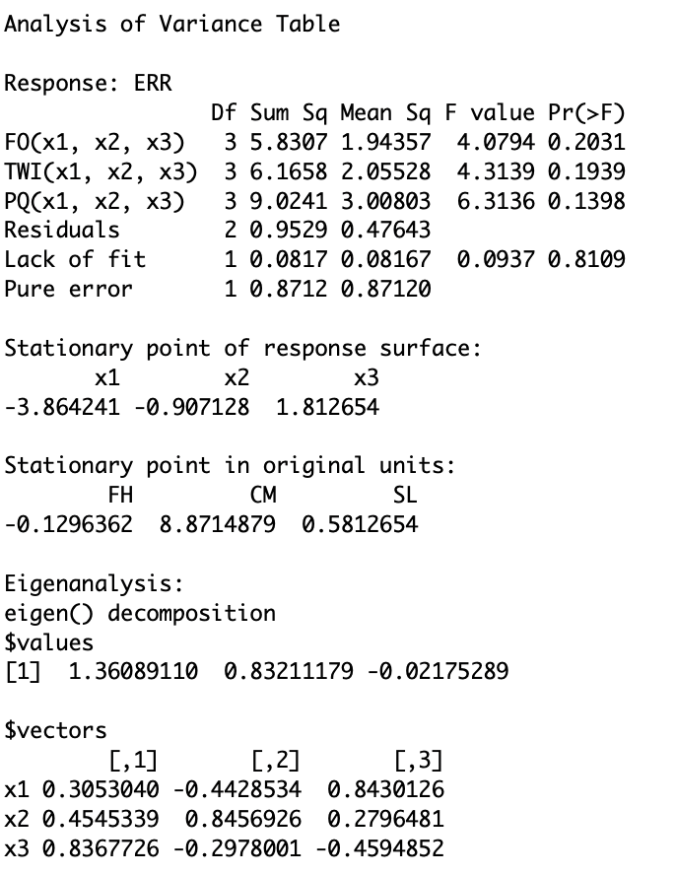
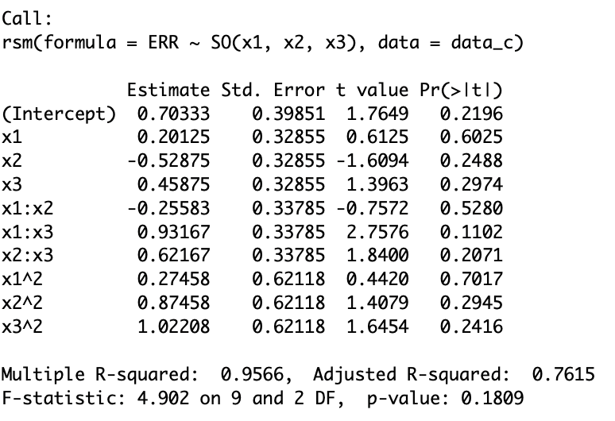
2. RSM model summary
SO(x1,x2,x3)

Slide 15
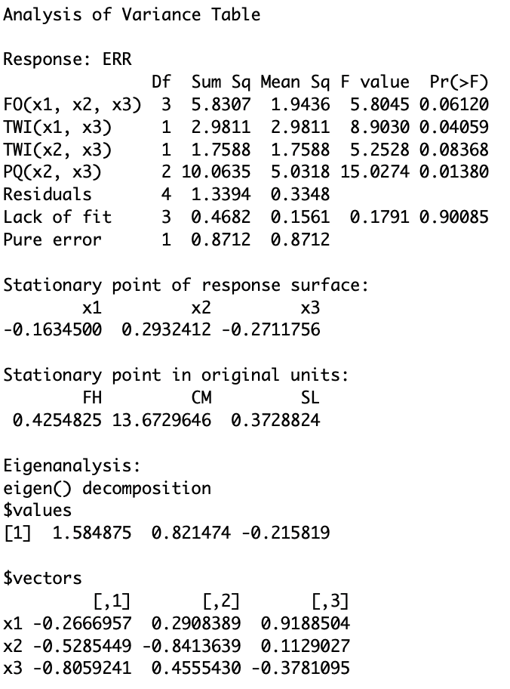
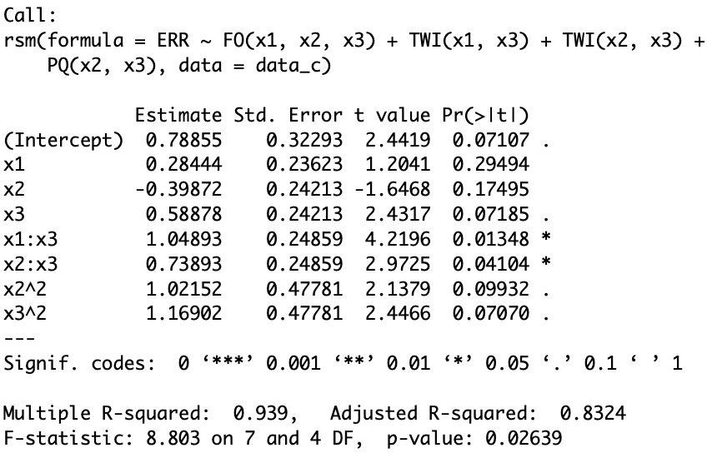
FO(x1,x2,x3)+TWI(x1,x3)+TWI(x2,x3)+PQ(x2,x3)

